Slide 1
ITEC113 Algorithms and Programming Techniques
Lecture 2 : Selection Statements

Slide 2
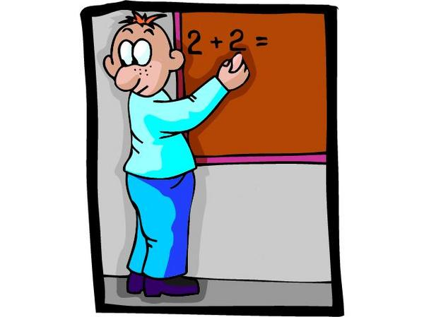
Recap

Slide 3
Definition of algorithm
A procedure for solving a mathematical problem in a finite number of steps that frequently involves repetition of an operation
a step-by-step procedure for solving a problem or accomplishing some end especially by a computer
Source: http://www.merriam-webster.com/

Slide 4
So what is an algorithm?
A recipe or a set of step-by-step instructions that describe a solution to a given problem.
In the context of computer programming
“well-ordered collection of unambiguous and effectively computable operations, that when executed, produces a result and halts in a finite amount of time.”

Slide 5
Characteristics of an Algorithm
Well-ordered: the steps are in a clear order
Unambiguous : the operations are understood by the computer module without any further simplification
Effectively computable: the computer module can actually complete the execution of the specified operations in a finite amount of time

Slide 6
Method for Developing an Algorithm
Define the problem : Describe the problem in clear and brief terms
List inputs : Clearly specify information needed for the solution of the problem (can be input from the keyboard, a file etc)
List outputs : Describe the result that the algorithm will produce
Describe the steps needed to accomplish the desired result : How to manipulate/use the inputs to produce the desired output
Test the algorithm : Verify that the algorithm works.

Slide 7
Structured Programming
All programs can be written using three control structures
Sequence :
one statement is executed after another
Selection :
A statement is executed or skipped depending on whether a condition evaluates to TRUE or FALSE. Example: if, switch
Repetition :
Statements are executed repeatedly until a condition evaluates to TRUE or FALSE. Example: while, for
Notes:
All programs can be written using three control structures
Sequence :
one statement is executed after another
Selection :
A statement is executed or skipped depending on whether a condition evaluates to TRUE or FALSE. Example: if, switch
Repetition :
Statements are executed repeatedly until a condition evaluates to TRUE or FALSE. Example: while, for

Slide 8
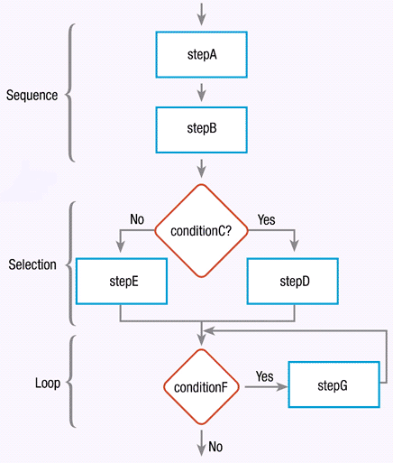

Slide 9
Pseudocode
Consists of natural language-like statements that precisely describe the steps of an algorithm or program
Statements describe actions
Focuses on the logic of the algorithm or program
No language-specific elements
Written at a level so that the desired programming code can be generated almost automatically from each statement
Keywords written using upper case letters
(Optional) Steps are numbered.
Subordinate numbers and/or indentation are used for dependent statements in selection and repetition structures
(Optional) Variables and Constants are declared

Slide 10
PseudoCode Constructs
Assignment:
Set num1 to 1
Num1 ←1
Computation
Use all arithmetic operators: addition (+), subtraction (-) . Division (/), multiplication (*), modulus (%) …
Input
Input : to enter from the keyboard
Read : to read from a file
Output
Display : to display on screen
Print : to print on the printer
Selection
IF .. END IF
IF .. ELSE …END IF
IF .. ELSE IF .. ELSE …END IF
SWITCH .. CASE …
Repetition (Will be covered later)
You can use either one of these assignment statements. We prefer the second one

Slide 11
FLOWCHARTING SHAPES
Flowcharting Symbols
Symbol | Name | Function
 | Terminal | Indicates the starting or ending of the program
 | Input | Used for data entry from keyboard.
 | Display | Used for displaying on screen
 | Process | Indicates any type of internal operation inside the Processor or Memory (STORE INFORMATION & DO CALCULATIONS -variables)
 | Decision | Used to ask a question that can be answered in a binary format (Yes/No, True/False)
 | Connector | Allows the flowchart to be drawn without intersecting lines or without a reverse flow.
 | Predefined Process | Used to invoke a subroutine or an interrupt program.

Slide 12
Rules for flowcharting
All boxes of the flowchart are connected with Arrows. (Not lines)
Flowchart symbols have an entry point on the top of the symbol with no other entry points.
Exception : connector symbol circle used in loops!
The exit point for all flowchart symbols is on the bottom.
Exception: The Decision symbol has two exit points; these can be on the sides or the bottom and one side.
Generally a flowchart will flow from top to bottom, and left to right.
Connectors are used to connect breaks in the flowchart. Examples are:
From one page to another page.
From the bottom of the page to the top of the same page.
Subroutines have their own and independent flowcharts.
All flow charts start with a Terminal or Predefined Process symbol.
All flowcharts end with a terminal.

Slide 13
Benefits of Flowcharts
Make communication on the logic of a system easier.
Make analysis of the problem more effective and easier
Serve as a good program documentation, which is needed for various purposes.
Act as a guide or blueprint during the systems analysis and program development phase.
Aid in debugging process.
Make maintenance of programs easier

Slide 14
Sequence Statements
Statements are executed one after the other in the same order as they are written
Default execution!
Example : Read a number from keyboard and display its square on screen
START
num1
INPUT num1
Sq ← num1*num1
DISPLAY sq
sq ← num1*num1
sq
END

Slide 15
Selection Statements
Selection statements: decide whether or not to execute a particular statement
Also called the conditional statements or decision statements
IF Statement is a flexible construct where you can use any condition that evaluates to TRUE or FALSE.
Branching is determined by the condition.
Switch Statement: Branching depends on the values the parameter may take.

Slide 16
Selection Statements: Simple If
Decides whether the statement-block of the if statement will be executed or not.
The statement-block may be a single statement or a group of statements.
If the test expression is true, the statement-block will be executed
otherwise the statement-block will be skipped

Slide 17
Selection Statements: Simple If
Example: Prompt the user to enter a number and print “positive” if number is greater than 0.
START
num1
INPUT num1
IF num1>0
DISPLAY “Positive”
ENDIF
FALSE
? Num1>0
TRUE
“Positive”
END

Slide 18
Selection Statement: If ..else
This is an extension of simple if where one of two branches is selected by the if condition.
If the test expression is true , then the true-block statement(s), immediately following the if statement are executed
otherwise the false-block statement(s) are executed.
Either true-block or false-block will be executed, not both.

Slide 19
Selection Statements: If .. else
Example: Prompt the user to enter a number and display “positive” if number is greater than 0, otherwise display “negative”.
START
num1
INPUT num1
IF num1>0
DISPLAY “Positive”
ELSE
DISPLAY “Negative”
ENDIF
FALSE
? num1>0
TRUE
“Positive”
“Positive”
END

Slide 20
Part 2 : New Material
Nested Selection statements
Loops

Slide 21
Selection Statements: If .. Elseif ladder
Multipath decisions are represented using IF ELSEIF ladder.
A multipath decision is a chain of IF statements in which the statement associated with each ELSE is an IF.
The conditions are evaluated from the top downwards.
As soon as a TRUE condition is found, the statement associated with it is executed and IF statement exits.
When all the all conditions enumerated as ELSEIF statements become FALSE, the final ELSE containing the default statement will be executed.

Slide 22
Selection Statements: If .. else
Example: Prompt the user to enter a number and print “positive” if number is greater than 0, if the number if less than 0 print “negative”, otherwise print “Zero”
START
num1
INPUT num1
IF num1>0
DISPLAY “Positive”
ELSEIF num1<0
DISPLAY “Negative”
ELSE
DISPLAY “Zero”
ENDIF
FALSE
? num1<0
FALSE
? num1>0
TRUE
TRUE
“Negative”
“Positive”
“Zero”
END

Slide 23
Selection Statements: Nested If’s
When a series of decisions are involved, more than one if.....else statement may be used in nested form.
Nesting can be done in IF, ELSEIF or ELSE parts if the if statement.
It is possible to nest very large number of if statements but readability of the program/algorithm will be reduced!

Slide 24
Selection Statements: If .. else
Example: Prompt the user to enter a number and print “positive” if number is greater than 0, if the number if less than 0 print “negative”, otherwise print “Zero”
START
num1
INPUT num1
IF num1<0
DISPLAY “Negative”
ELSE
IF num1>0
DISPLAY “Positive”
ELSE
DISPLAY “Zero”
ENDIF
ENDIF
FALSE
? num1>0
FALSE
? num1>=0
TRUE
TRUE
“Positive”
“Negative”
“Zero”
END

Slide 25
Selection Statements: If .. else
Example: Prompt the user to enter a number and print “positive” if number is greater than 0, if the number if less than 0 print “negative”, otherwise print “Zero”
START
num1
INPUT num1
IF num1>=0
IF num1>0
DISPLAY “Positive”
ELSE
DISPLAY “Zero”
ENDIF
ELSE
DISPLAY “Negative”
ENDIF
“Negative”
FALSE
? num1>=0
TRUE
“Zero”
FALSE
? num1>0
TRUE
“Positive”
END

Slide 26
Looping Statements
Loops are used to perform repetitive tasks
such as printing sequential numbers on screen.
The statements enclosed inside a loop are usually executed more than once.
Each execution is called an iteration.

Slide 28
Flowchart Loops
A live performance
of walking to a chair and sitting on it!

Slide 29
START
TAKE ONE PACE
FORWARD
IS CHAIR
IN FRONT
OF YOU?
NO
YES

Slide 30
START
TAKE ONE PACE
FORWARD
IS CHAIR
IN FRONT
OF YOU?
NO
YES

Slide 31
START
TAKE ONE PACE
FORWARD
IS CHAIR
IN FRONT
OF YOU?
NO
YES

Slide 32
START
TAKE ONE PACE
FORWARD
IS CHAIR
IN FRONT
OF YOU?
NO
YES
TURN AROUND
AND SIT ON IT
STOP

Slide 33
WHILE …… ENDWHILE loop : characteristics
Iteration count is greater than and equal to 0 (zero).
If the condition is initially FALSE Loop Body will never be executed.
Working Mechanism : First Check then Execute
The loop is repeated as long as the condition is true!

Slide 34
WHILE …… ENDWHILE loop : structure
WHILE condition
Instruction-1
Instruction-2
…
ENDWHILE
?
Condition
NO
YES
Instruction 1
Instruction 2
….

Slide 35
WHILE …… ENDWHILE loop : example
Display all integer numbers between 1 and 10 on screen. The boundaries (1 and 10) should also be displayed.
START
i ← 1
i ←1
WHILE i <= 10
Display i
i ← i +1
ENDWHILE
?
i<=10
NO
YES
i
END
i ← i + 1

Slide 36
DO…..WHILE loop : characteristics
Iteration time is greater than and equal to 1 .
Even if the condition is initially FALSE the Loop will be executed at least once.
Working Mechanism is First Execute and Then Check
Iterations are carried out while condition is TRUE, and stopped when the condition is FALSE.

Slide 37
DO…..WHILE loop : structure
DO
Instruction-1
Instruction-2
…
WHILE condition
Instruction 1
Instruction 2
….
?
Condition
YES
NO

Slide 38
DO…..WHILE loop : example
Display all integer numbers between 1 and 10 on screen. The boundaries (1 and 10) should also be displayed.
START
i ← 1
i ←1
DO
Display i
i ← i+1
WHILE i <= 10
i
i ← i + 1
?
i<=10
YES
NO
END

Slide 39
REPEAT…..UNTIL loop : characteristics
Iteration time is greater than or equal to 1 .
Even if the condition is initially TRUE the Loop will be executed at least once.
Working Mechanism is First Execute and Then Check
Iterations are carried out while condition is FALSE, and stopped when the condition is TRUE.

Slide 40
REPEAT…..UNTIL loop : structure
Instruction 1
Instruction 2
….
REPEAT
Instruction-1
Instruction-2
…
UNTIL condition
?
Condition
NO
YES

Slide 41
REPEAT…..UNTIL loop : example
Display all integer numbers between 1 and 10 on screen. The boundaries (1 and 10) should also be displayed.
START
i ← 1
i ← 1
REPEAT
i ← i + 1
Display i
UNTIL i > 10
i
i ← i + 1
?
i>10
NO
YES
END

Slide 42
FOR … ENDFOR loop : characteristics
Repeated a "specific" number of times, determined by the program or the user.
"counts" the number of times the body will be executed.
good choice when the number of repetitions is known, or can be supplied by the user.

Slide 43
FOR … ENDFOR loop : structure
lowerlimit
Instruction 1
Instruction 2
….
YES
stepsize
Upper Limit
NO
FOR loopcounter=lowerlimit to upperlimit with increment = stepsize
Instruction-1
Instruction-2
…
ENDFOR

Slide 44
FOR … ENDFOR loop : example
Display all integer numbers between 1 and 10 on screen. The boundaries (1 and 10) should also be displayed.
START
i ← 1
?
i <=10
i ← 1
FOR i =1 to 10 with increments = 1
DISPLAY total
END FOR
i ← i + 1
NO
YES
i ← i + 1
END
i

Slide 45
The End

